Slide 1


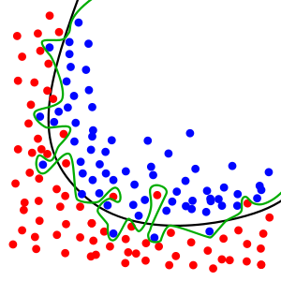
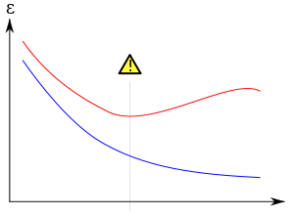
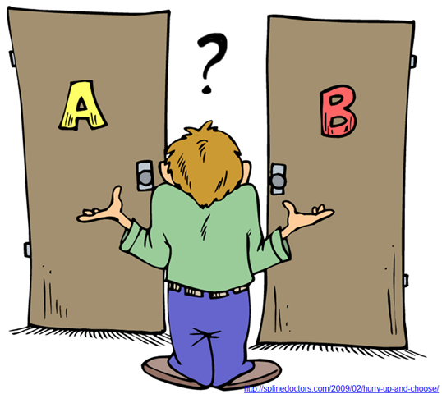
Winner Experiences of KDD Cup & Features Selection
Associate Professor HUANG, Ke-Wei

Slide 2
Case 1: KDD Cup 2009
The task:
Two anonymized data sets
Each of 50,000 mobile teleco customers and each entry having 15,000 variables.
The task was to find the best churn, up-, and cross-sell models.
The winner uses GBM on standard Windows laptops (Intel Core 2 Duo 2.66GHz processor, 2GB RAM, 120Gb hard drive) against competitors that had more computing clusters available.
By R package.
Notes:
http://www.cybaea.net/Journal/2009/06/01/How-to-win-the-KDD-Cup-Challenge-with-R-and-gbm/

Slide 3
KDD Cup 2009 --- Pre-processing
The way to create smaller number of categories in this paper is simple. The authors keep the top 10 commonly appeared categories and then group everything else into type 11. next, they create 11 dummy variables to represent 11 categories.
From Dr. Huang:
If your feature has a naturally defined hierarchy (product versus product categories), use the higher-level hierarchy to reduce the number of categories.
You can use rpart (which is a binary tree) to create a binary hierarchy to reduce the number of categories while the prediction performance is still good by that individual feature.
Notes:
http://www.cybaea.net/Journal/2009/05/31/R-used-by-KDD-2009-cup-winner-of-slow-challenge/

Slide 4
KDD Cup 2009 --- Pre-processing
Missing Value: We replaced the missing values by mean for numerical attributes, and coded them as a separate value for discrete attributes. We also added a separate column for each numeric attribute with missing values, indicating whether the value was missing or not. We also tried another approach for imputing missing values based on KNN.
From Dr. Huang:
This approach is fine in general.
It is good to add a dummy variable to indicate missing or not, this is part of the solution.
Imputation (fill missing value) may not be optimal in many cases.
There is no perfect solution in theory. People all use simple solutions like this champion even today
Notes:
http://www.cybaea.net/Journal/2009/05/31/R-used-by-KDD-2009-cup-winner-of-slow-challenge/

Slide 5
Handling Missing Value
From Dr. Huang:
Decision tree (among some other algorithms) can handle missing values directly. Especially rpart has built-in algorithm to handle missing values.
If your main algorithm cannot handle missing values, you can impute that missing value by building a prediction model.
Or, you can consider the following approach.
Suppose you have two features (X1, X2) that have missing values. Then you train 4 models. One model include both X1 and X2 (but drop observations with missing values). One model with only X1, One model with only X2, and one model without X1 or X2 (then you can use full training dataset).
For prediction, because you have 4 models, you can handle any case of missing values.
The problem of this approach is when you have many features with missing values, the number of models will explosively grow. You need to drop some features with missing values (or impute those features).
Notes:
http://www.cybaea.net/Journal/2009/05/31/R-used-by-KDD-2009-cup-winner-of-slow-challenge/

Slide 6
Definitions of Features Engineering
Feature engineering is the process of using domain knowledge of the data to create features that make machine learning or data mining algorithms work.
Coming up with features is difficult, time-consuming, requires expert knowledge. "Applied machine learning" is basically feature engineering.
by Andrew Ng, Machine Learning and AI via Brain simulations
Most features engineering are “manual” while there are very new research and commercial products claim that they can automate features engineering to some extent => typically they just use naïve features engineering similar to what I demoed during the neural network lecture.

Slide 7
KDD Cup 2009 --- Features Engineering
From the authors, examples of features engineering
For categorical variables authors just took the average number of 1's in the response for each category and used this as a new predictor.
For example, if the number for male is 5% and the number for female is 10%, we replace male/female by 5%/10%.
For continuous variables authors split the variable up into "bins", as you would a histogram, and again took the average number of 1's in the response for each bin as the predictor.
From this authors came up with a set of about 200 new variables for each model.
Notes:
http://www.cybaea.net/Journal/2009/06/01/How-to-win-the-KDD-Cup-Challenge-with-R-and-gbm/

Slide 8
KDD Cup 2009 --- Features Selection
They looked at how effective each individual variable was as a predictor, which also allowed them to read parts of the data only, as the whole dataset didn’t fit in memory.
PCA does not work well according to the authors.
They did not explain the details how to calculate the individual contribution.
In general, you can use (1) regression (incremental contribution to R^2 in forward step-wise regression) (2) random forest (3) any method that can output individual contribution.
More on this later this lecture.
They split the data into half for evaluating the performance.
Notes:
http://www.cybaea.net/Journal/2009/06/01/How-to-win-the-KDD-Cup-Challenge-with-R-and-gbm/

Slide 9
KDD Cup 2009 --- Method
The main model was a gradient boosted machine which used the “gbm” package in R.
They used Bernoulli loss and also up-weighted the "1" response class to alleviate the problem of imbalanced label.
A fair amount of time was spent optimising the number of trees, but a fit of 5,000 trees only took a bit over an hour to fit. The package itself is quite powerful as it gives some useful diagnostics such as relative variable importance, allowing us to exclude some and include others.
They used trees to avoid doing much data cleaning – GBM automatically allow for extreme results, non-linearity, missing values and handle both categorical and continuous variables.
Notes:
http://www.cybaea.net/Journal/2009/06/01/How-to-win-the-KDD-Cup-Challenge-with-R-and-gbm/

Slide 10
Case 2: KDD Cup 2014
The task: predicting whether funding requests from teachers are ”exciting” (high quality). If exceptional projects can be identified earlier, funding outcome can be improved.
Input: several data files describing past project details, donation details, resource details and school information.
Output: a probability about whether the project is “exciting” or not. (the project is of high quality, fully-funded, receive donation from many donators or the donation is in large amount etc.)
Notes:
https://kaggle2.blob.core.windows.net/forum-message-attachments/51183/1427/kdd_2014_documentation.pdf

Slide 11
KDD Cup 2014 --- Features Engineering
The 1st winner found ”history” variable being very important in explaining the probability of whether the project was ”exciting”.
Aggregate past successful projects or donors’ details at school level, teacher level or region level
This school had higher number of “exciting” projects in the past
This teacher had higher number of projects with more (positive) comments from donators
Problem context might suggest that past impression of a school and a teacher matters. When donators are not familiar with both projects, project applied by “well known” schools and teachers get higher chance to receive donation.

Slide 12
KDD Cup 2014 --- Features Engineering
The 2nd winner built two models.
The first model was similar to the 1st winner, used past information about teachers and donations if there was sufficient information.
The second one was designed for teacher with low project history, thus relied more on the textual information included in project application. In particular, the name of the most expensive items in the project (e.g. computers) mattered.
Notes:
https://www.datarobot.com/blog/datarobot-the-2014-kdd-cup/

Slide 13
KDD Cup 2014 --- Features Engineering
For “history” features, they sliced time into chunks of 4 months, computed statistics for each chunk, and used the last 3 chunks prior to the time of project as input.
Stats included past projects posted by teachers, donations received by teachers, donations made by the teachers, donations made by the zipcode, city, state of the project.
Another interesting finding is that features based on donations made by teachers were more predictive than features based on donations received by them.
If one teacher donates to exciting projects, she is more likely to post exciting projects herself, (or perhaps vice versa? causality unclear)
Hypothesis: ”Good” teacher are more willing to share resources with each other, more willing to donate to “good” projects proposed by other “good” teachers
Notes:
https://www.datarobot.com/blog/datarobot-the-2014-kdd-cup/

Slide 14
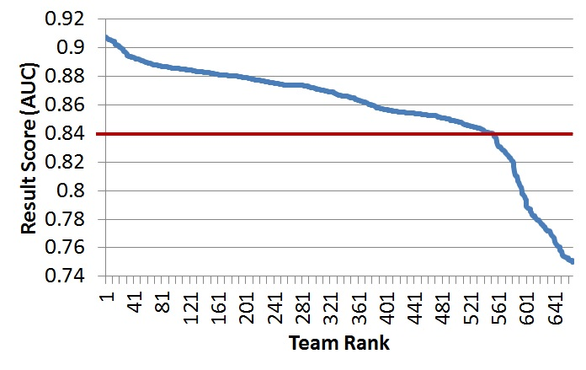
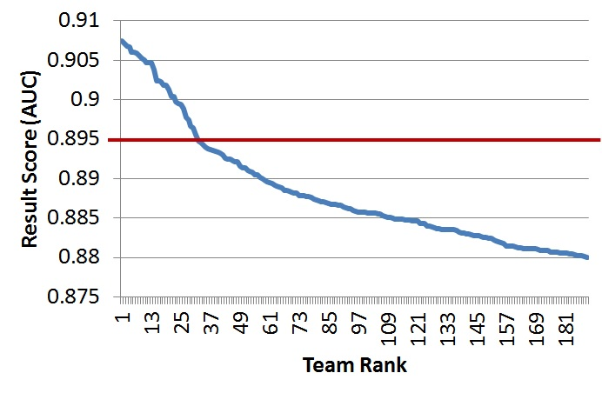
Case 3: KDD Cup 2015
Task: The objective was to predict student dropouts from online courses.
The quality of submitted predictions was measured in terms of AUC score, while the highest achieved score was 0.9074.
Some interesting stats. from the organizer.
Notes:
https://www.kdnuggets.com/2015/08/kdd-cup-present-future.html

Slide 15
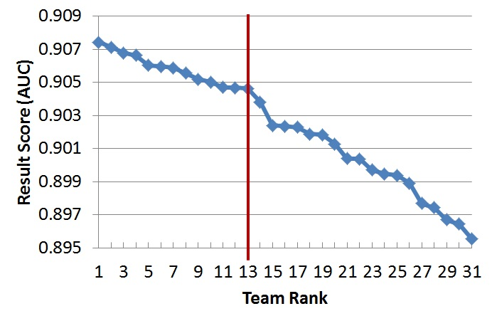
KDD Cup 2015
The top 13 teams look truly outstanding: their scores are very close to each other, while a significant drop can be seen afterwards.
Notes:
https://www.kdnuggets.com/2015/08/kdd-cup-present-future.html

Slide 16
Three Main Takeaways by Competition Chair
Something dramatic happened in Machine Learning over the past couple of years. It is called XGBoost – a package implementing Gradient Boosted Decision Trees that works wonders in data classification. The chair of competition had tried it on benchmark dataset – it shows 35% improvement over an SVM. Apparently, every winning team used XGBoost, mostly in ensembles with other classifiers. Sometimes an ensemble of (parametrized) XGBoosts was used – without other classifiers ☺. Most surprisingly, the winning teams report very minor improvements that ensembles bring over a single well-configured XGBoost. After all, in contrary to common belief, one might not need to build an ensemble to win a Data Science competition.

Slide 17
Three Main Takeaways
2. Feature Engineering is the king. This fact is as well-known as the superiority of ensembles – but in contrast to ensembles, feature engineering is not going anywhere. Teams are very creative about features, and this is what at the end wins the KDD Cup. It is worth mentioning that one winning team reported achieving 0.9 AUC with “basic” features and a single XGBoost (they then concentrated on adding less-basic features). Funnily, 800 competing teams never achieved 0.9 AUC. You can make a conclusion about the “basicness” of features this team came up with.

Slide 18
Three Main Takeaways
Team work is crucial. You can win KDD Cup only in a team – the first four winning teams were 4 to 21 people in size. The best solo contestant came to the 5th place. Within a team, the most important role of every team member is to bring features. Often, team members start working independently not to get exposed to each other’s features, and merge their results later. Quite often, the teams are not even planning to work together early during the competition – they decide to run together once they establish their benchmarks and have reasons to assume that the collaboration will furthermore improve the results.

Slide 19
Case 4: KDD 2016
Predict the ranking of affiliations (universities, research institutions, and companies) at 6 top data mining and machine learning conferences in 2016.
A true prediction task in 2016.
Input => Microsoft Academic Graph.
Step 1: First things first, looking at the trends and descriptive statistics of data. Formulate assumptions about how to predict based on domain knowledge.
Step 2: Build a solid baseline model.
Notes:
http://www.vladsandulescu.com/the-winning-solution-to-the-kdd-cup-2016/
The task? The research task was to predict the ranking of affiliations (universities, research institutions or companies) based on the number of their accepted full research papers at 8 future academic conferences in 2016. Each research paper is written by a number of authors, each affiliated to an university or company. The authors of a paper receive equal scores (1/number of paper authors) for each accepted paper. Then the score for each of the affiliations is simply the sum of these author scores. The affiliations are ranked according to these scores (also called ‘relevance’ by the competition organizers) and this represents the predicted ranking in the competition.

Slide 20
KDD 2016
Step 3: Use fixed/random effect regressions to get transparent results about the contribution of each attribute. Use gradient boosted decision trees (GBDT) to boost prediction accuracy.
Step 4: The goal is to predict only 6 conferences. The authors expand the training dataset by including more conferences similar to the top 6 conferences. “More data is always better”.
Step 5: FUN part => features engineering!
Notes:
http://www.vladsandulescu.com/the-winning-solution-to-the-kdd-cup-2016/
Fixed effect regression is for panel dataset. You can think of it as a linear regression (which is for cross-sectional dataset) but is for panel dataset.

Slide 21
KDD 2016
Features Engineering
Stats of all previous relevance scores (=DV) (std, sum, mean, median, min, max) of each affiliation
Previous relevance scores computed in windows from previous year up to 4 years ago
Stats of previous relevance scores (std, sum, mean, median, min, max) computed in windows from previous year up to 4 years ago
Drift trend of previous relevance scores
Exponential weighted moving average of previous relevance scores with estimated smoothing parameter
Exponential weighted moving average of previous relevance scores, computed with a fixed smoothing parameter
Notes:
http://www.vladsandulescu.com/the-winning-solution-to-the-kdd-cup-2016/

Slide 22
Last step
Dataset+Features+Baseline+Tuning=Profit
Final step in any competition is to polish your predictions through tuning.
Chose 3 well-known conferences for validation: FSE, MM and MOBICOM.
Search for the features configuration for which the GBDT model gives the best predictions for each of the conferences.
Perform a grid search on different combinations of features and numbers of related conferences.
Although the final feature sets was different overall between the conferences, some of the features do well across all conferences: the exponential smoothing features improved the final predictions for all of them.
Notes:
http://www.vladsandulescu.com/the-winning-solution-to-the-kdd-cup-2016/

Slide 23
Final Suggestions
Tidy up your data and explore it! I mean really explore it, plot it like crazy. Spend a lot of time on doing this because you will get that extra intuition to create awesome features.
You can squeeze some more performance by tuning your models or stacking them and the re-stacking them and then doing a final ensemble of it all, you know, the Kaggle way. But well thought out features will get you a much more elegant win.
Set up your own validation procedure and baseline model.
Try simple models first and move on to more complicated ones gradually. Simple models are interpretable and can help you spot new features.
Teamwork is very important because it acts as a natural ensemble. You will not get all the ideas yourself.

Slide 24
Case 5: KDD 2017
Task: To estimate the average travel time from designated intersections to tollgates
Data available: vehicle trajectories along routes, weather data in targeted region, road topology
Ccomplicated features engineering are one important winning strategies of top teams
Notes:
http://www.kdd.org/kdd2017/files/Task1_1stPlace.pdf

Slide 25
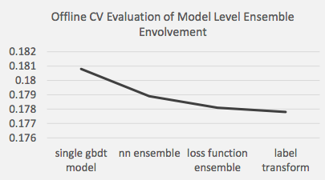
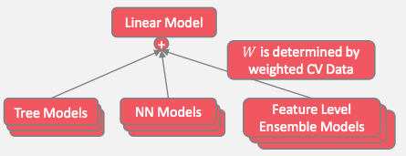
KDD 2017 --- Method
Ensemble learning - combine different models together, xgboost, lightGBM, neural network, recurrent neural network
Finally obtain 0.1748 mape
Notes:
http://www.kdd.org/kdd2017/files/Task1_1stPlace.pdf

Slide 26
Case 6: KDD 2018
Real-Time prediction of Air Quality (such as PM2.5) in Beijing and London for one month in May 2018.
Features: location of AQ monitoring stations, historical AQ variables, weather variables, and weather forecasts in all nearby locations.
Real spatio-temporal prediction
Methods: easy
Half of the top teams use XGBoost or LightGBM with ensemble.
Half of the top teams use RNN-LSTM variations.
Features engineering: relatively standard in this case, only the champion team created more complicated features based on nearby stations’ variables and wind direction influences.

